Slide 1
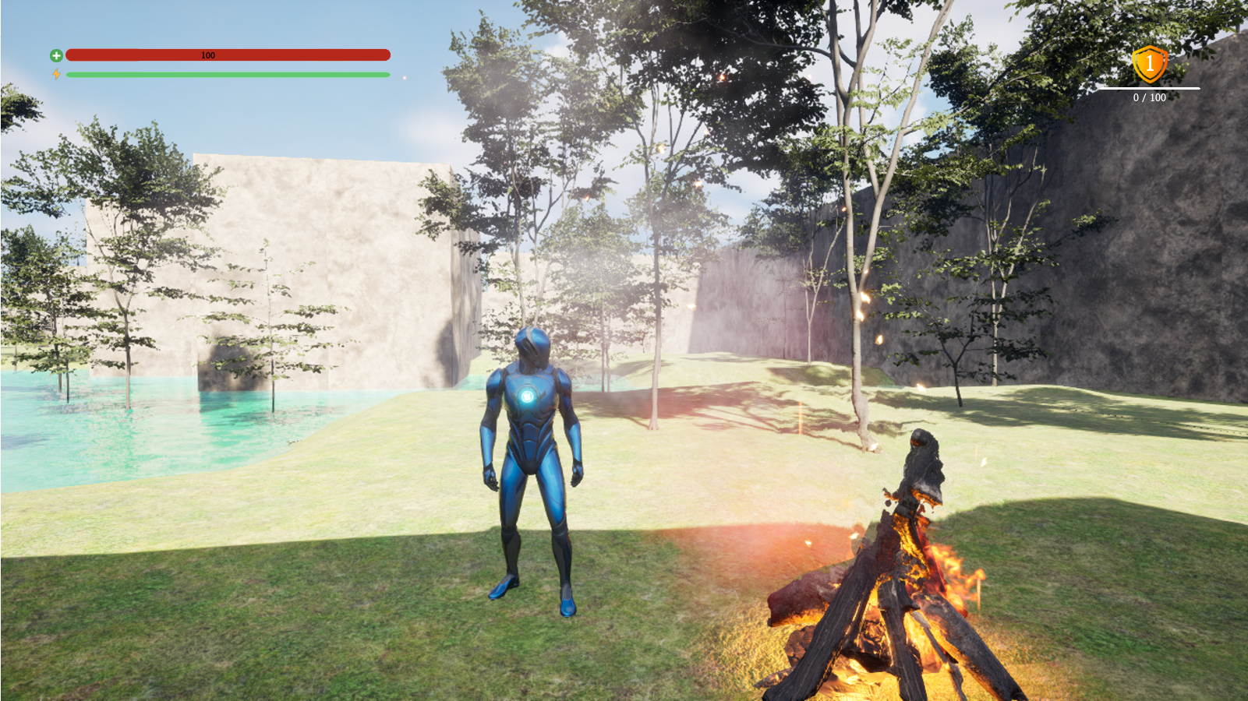
Project Tarnished
By JC Way

Slide 2
Outline
Brief description of project
Why I did this project
why the project is useful
The type of game
basic overview of what it does
WFC
how it works-basic
how mine works
show tiles and talk about them
how to improve
Demo game
Conclude

Slide 3
Description
Design a game for replayability
Procedural World Generation
Gameplay

Slide 4
Why I created this game
I love games
I want to be a game dev
UE is widely used

Slide 5
What is my game?
Melee combat game
Procedural world generation

Slide 6
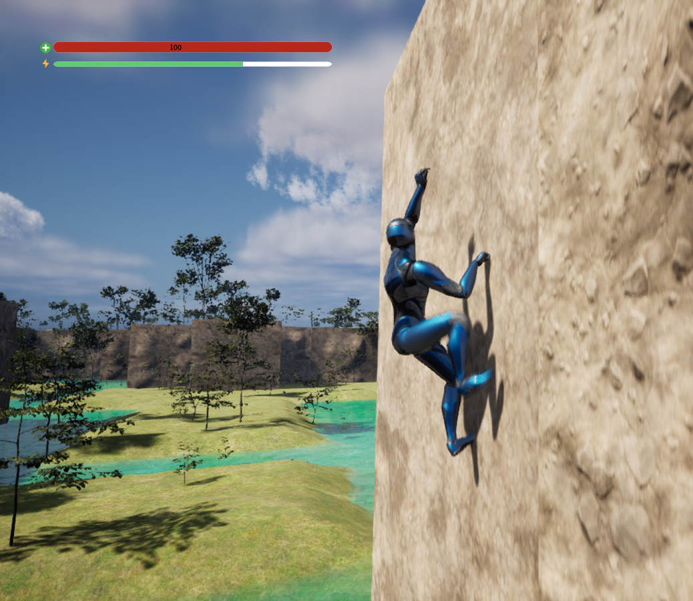
WFC
“a algorithm that can procedurally generate images, text, audio and almost anything that follows a pattern of a simple set of initial parameters and a set of rules. But the neat part is, wfc(short for wave function collapse) does all these without any artificial intelligence shenanigans”

Slide 7
Example

Slide 8
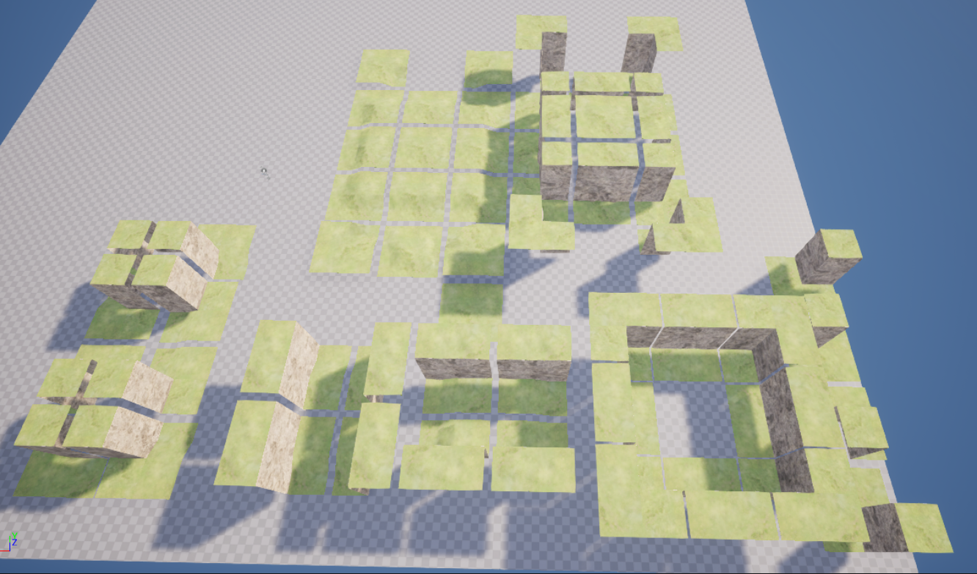
Tile map
56 Tile
Rotational Function: 19 tiles

Slide 9
Works Cited
https://dev.to/kavinbharathi/the-fascinating-wave-function-collapse-algorithm-4nc3#:~:text=Wave%20function%20collapse%20is%20a,without%20any%20artificial%20intelligence%20shenanigans.

